Slide 1
I am an Early Childhood Educator Claiming my voice
Support the ECE students
Showcasing Prince George
1. Inviting local photographers in partnership
with centres to document the “faces ” of ECEs.
2. Having an art gallery to showcase the ECE field
in Prince George
3. Publish the documentation.

Slide 2
Who’s ECE?

Slide 3
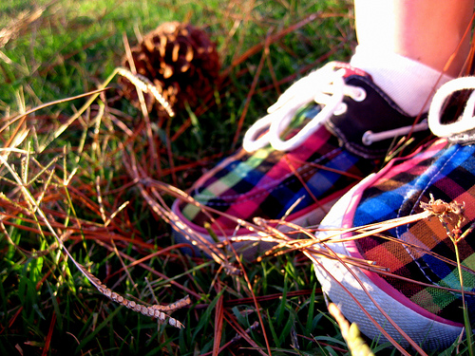
Early Childhood Educators respect and celebrate a child’s individuality

Slide 4
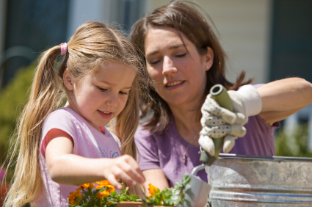
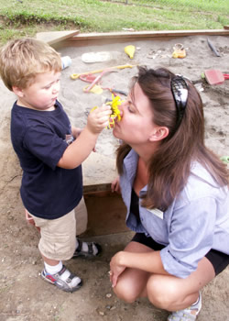
We develop curriculum
building on children’s interest

Slide 5
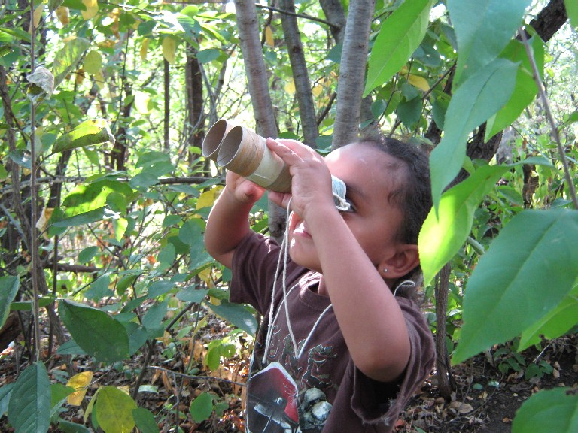
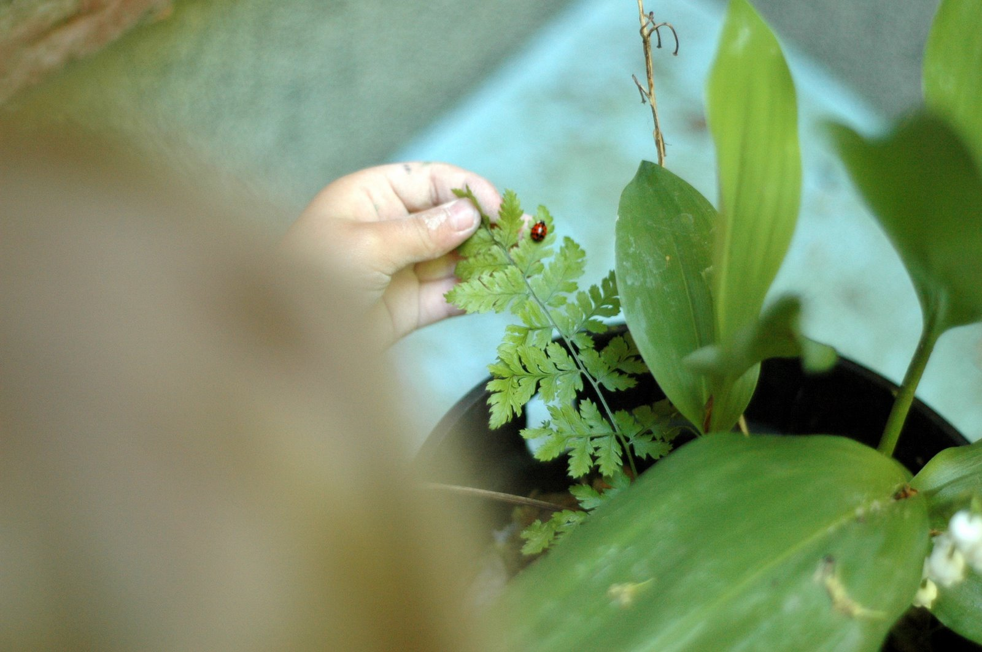
We encourage and stimulate children to explore the world

Slide 6
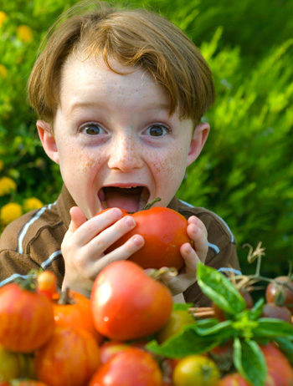
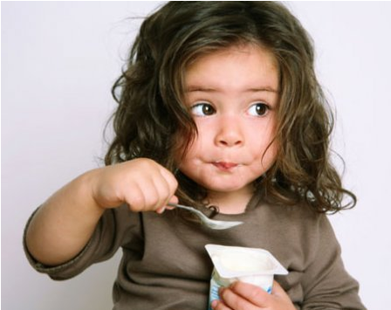
We model and promote healthy eating style.

Slide 7
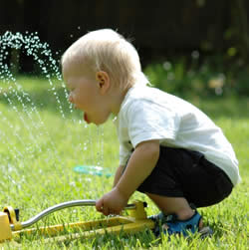
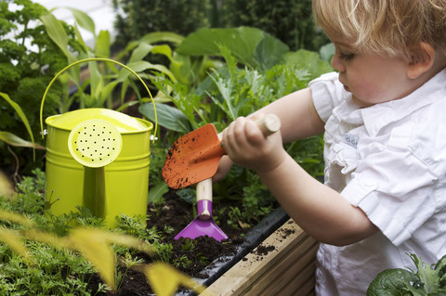
We know researches prove that children learn best through play

Slide 8
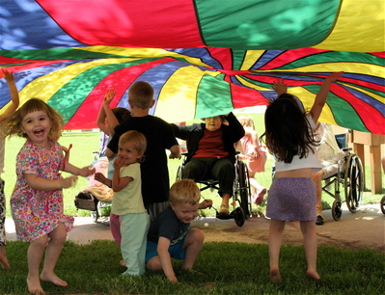
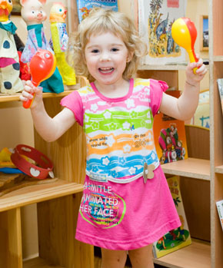
We appreciate the importance of music and movement

Slide 9
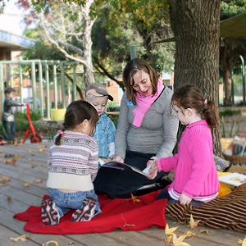
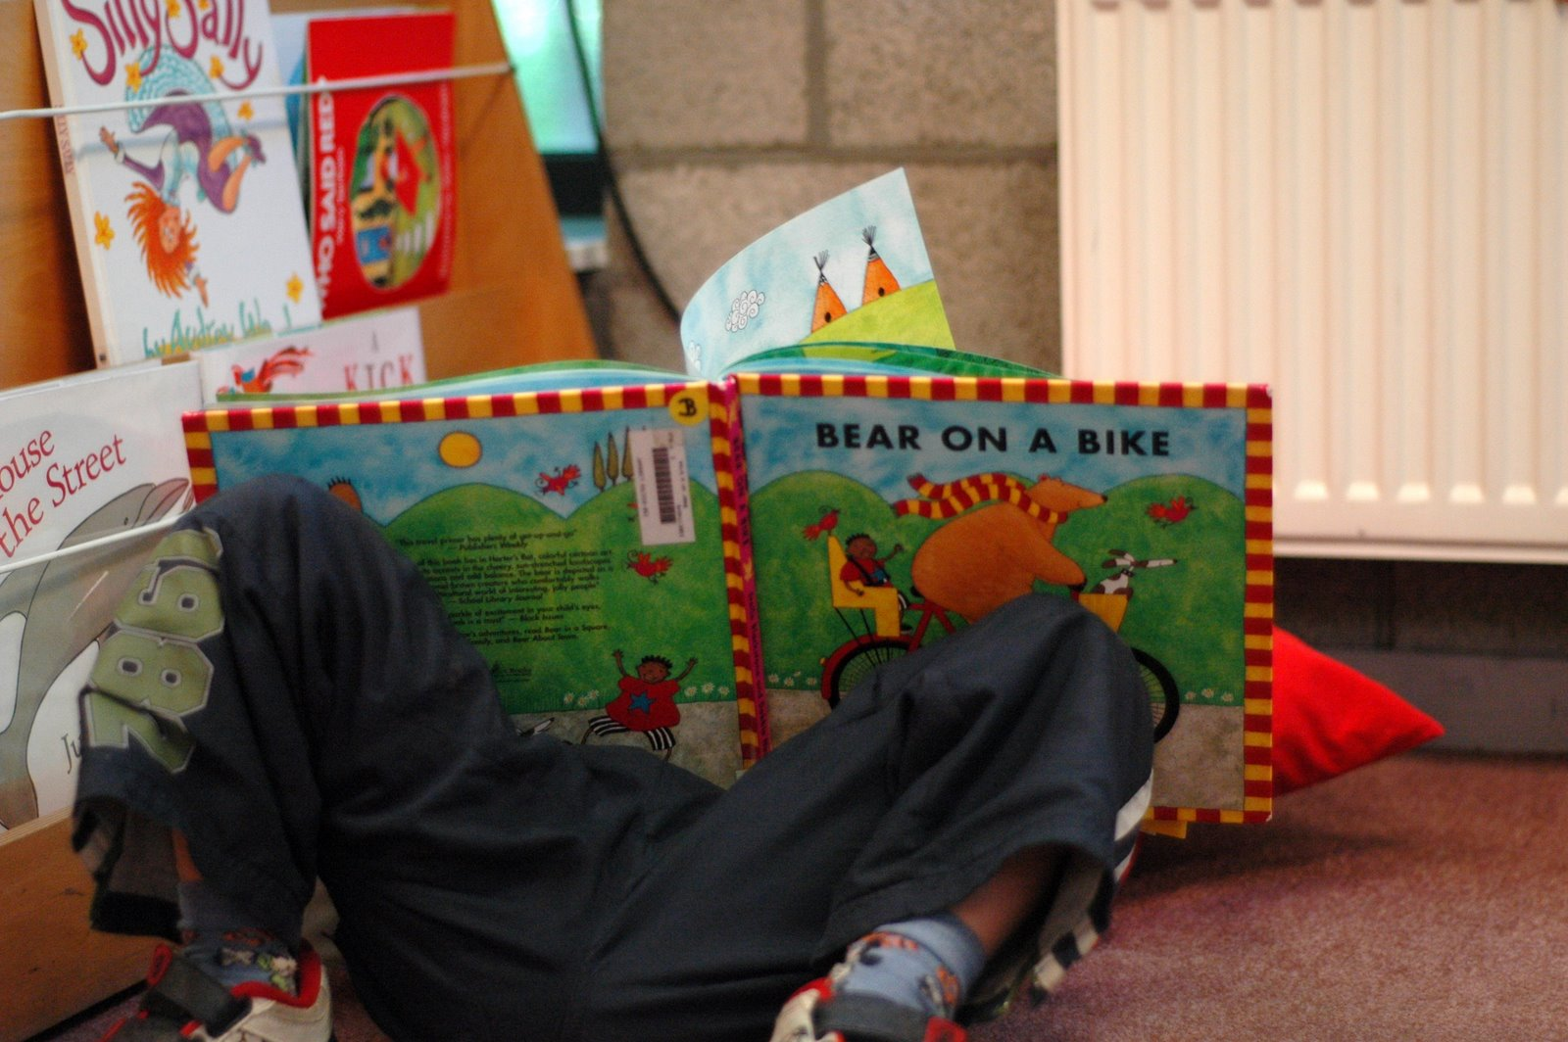
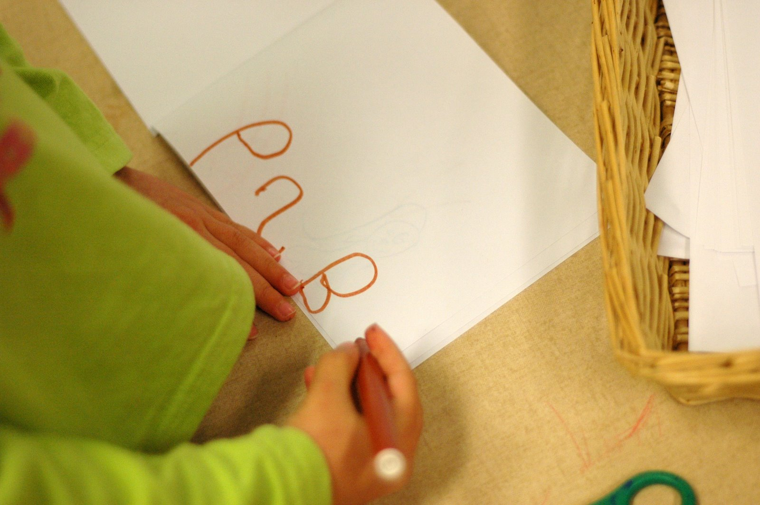
Early Childhood Educators help children develop early math, language and literacy skills

Slide 10
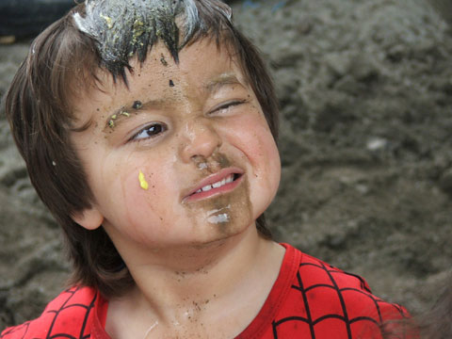
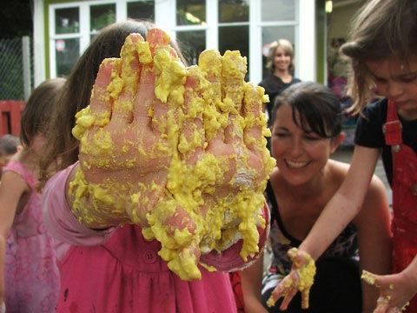
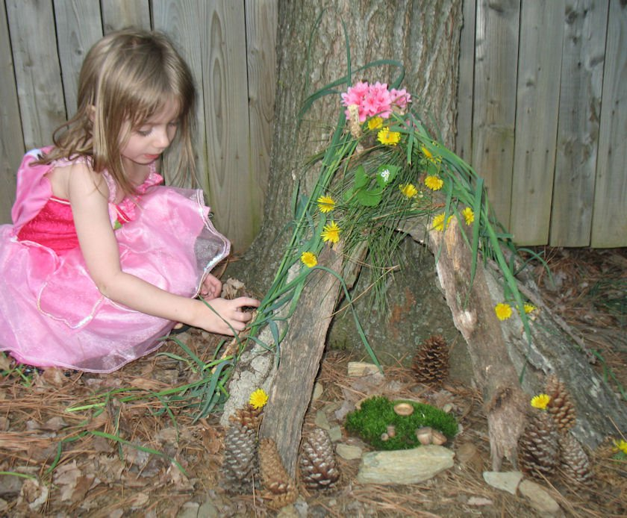
We foster children’s creativity and we don’t mind the messy play

Slide 11
Early Childhood Educators are trained professionals providing inclusive care and learning environment to all children

Slide 12
I am an Early Childhood Educator Claiming my voice
Support the ECE students
Showcasing Prince George
1. Inviting local photographers in partnership
with centres to document the “faces ” of ECEs.
2. Having an art gallery to showcase the ECE field
in Prince George
3. Publish the documentation.

Slide 13
I am an Early Childhood Educator Claiming my voice
How can you support the project?

