Slide 1



Quality Wilna t’ehl- early care and learning –cohort 5- Gitwangax-(kitwanga BC
This event was made possible by the following Organizations:
Gitwangax (Kitwanga) BC is very grateful to all who made this possible. A lot of hard work, dedication and commitment from the organizations , parents and community.

Slide 2
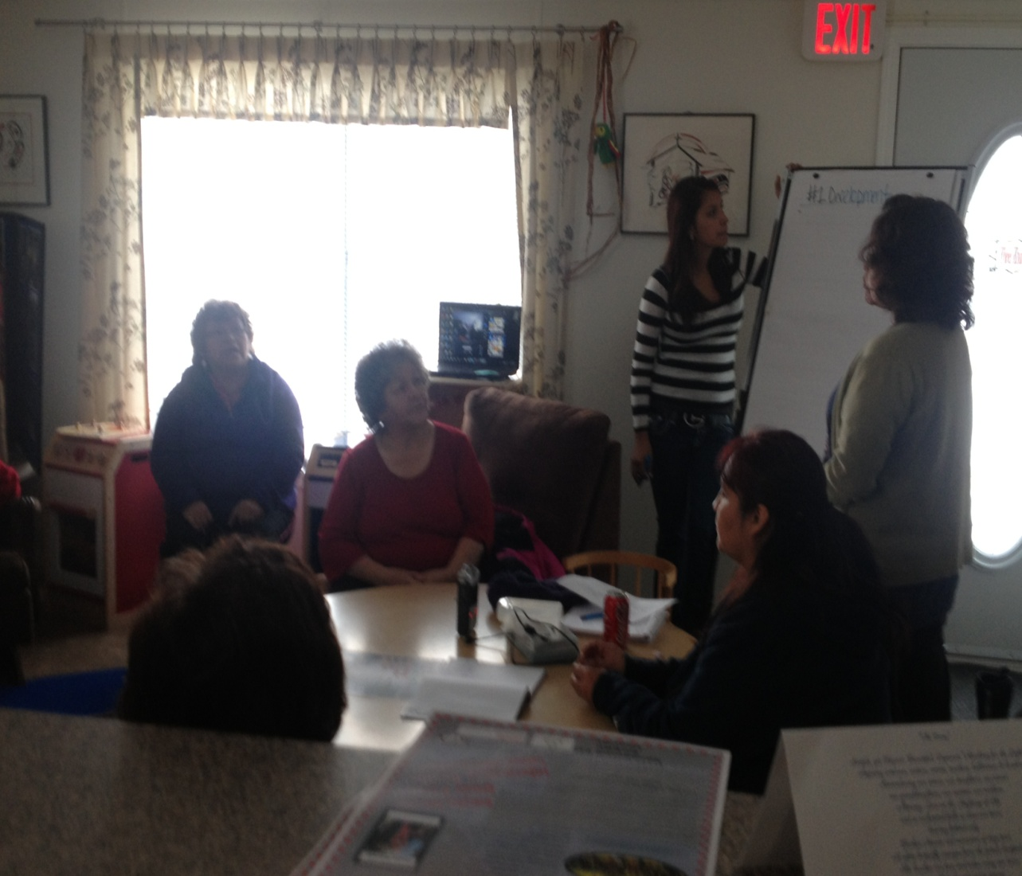
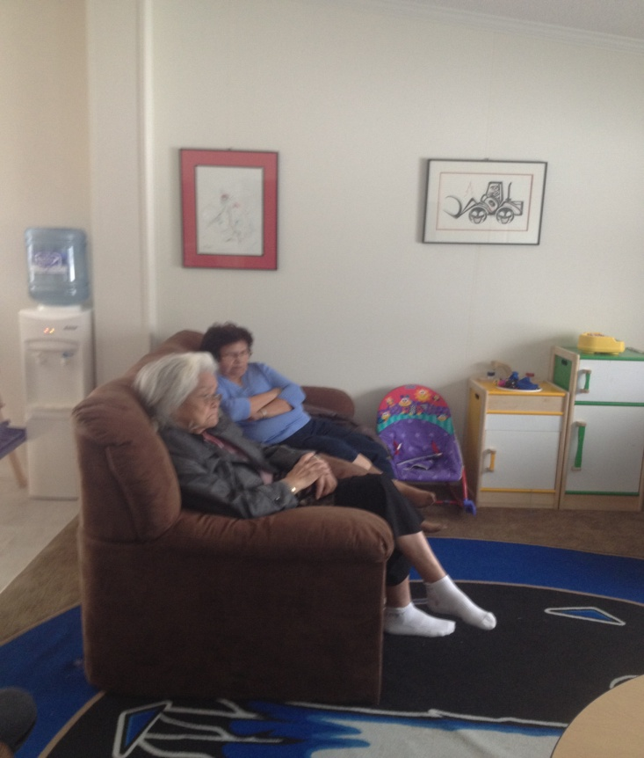
Elder Consultation- focus on Early care and learning
Jessica, Liz and Tammy continue to practice their leadership skills

Slide 3
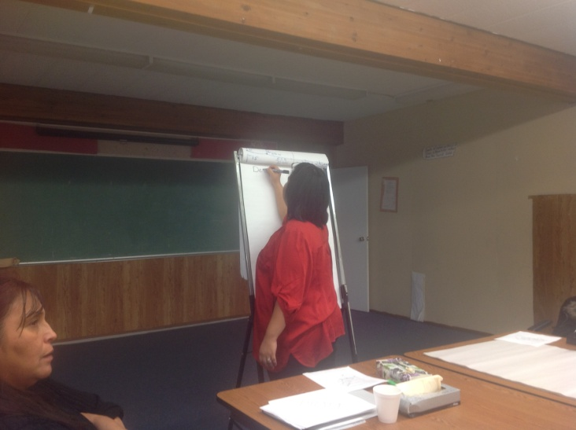
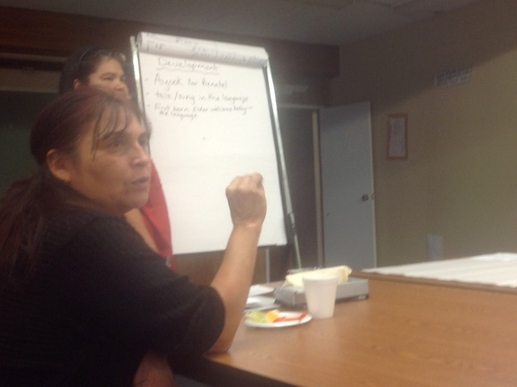
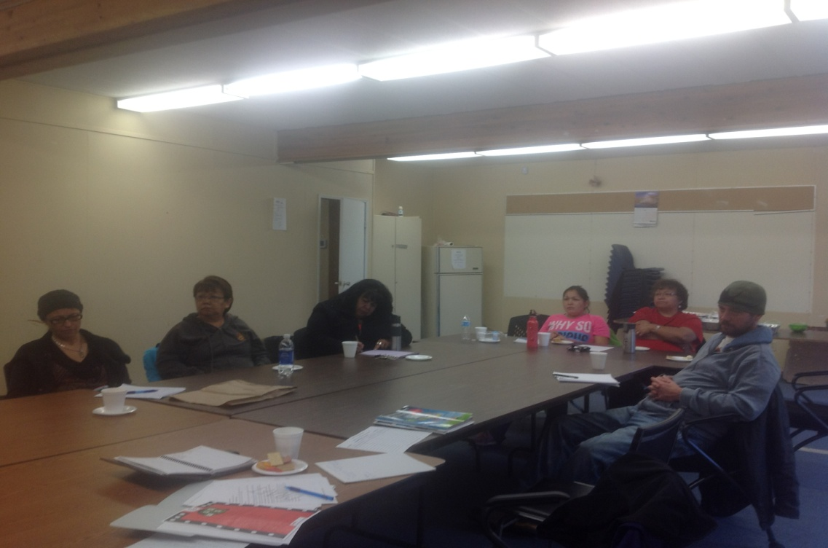
Community consultation

Slide 4
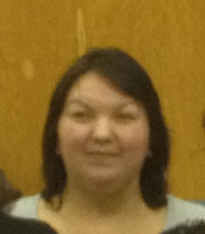
Coordinator for conference Jennifer Morgan
Roles and Responsibilities:
Invite and visit communities
Pick up Elders
Bring Elders home
Keep notes of meetings
Arrange Booths with service providers
Create any formal documents such as registration and consent forms
Provide input
Be enthusiastic
Be respectful at all times
Assist with tasks as needed to be prepared for the event
Assist with materials and set up of hall for event
Participate and take pictures of event
Ensure photographs are in order on computer
Assist with menu planning for both days and communicate with caterers.

Slide 5
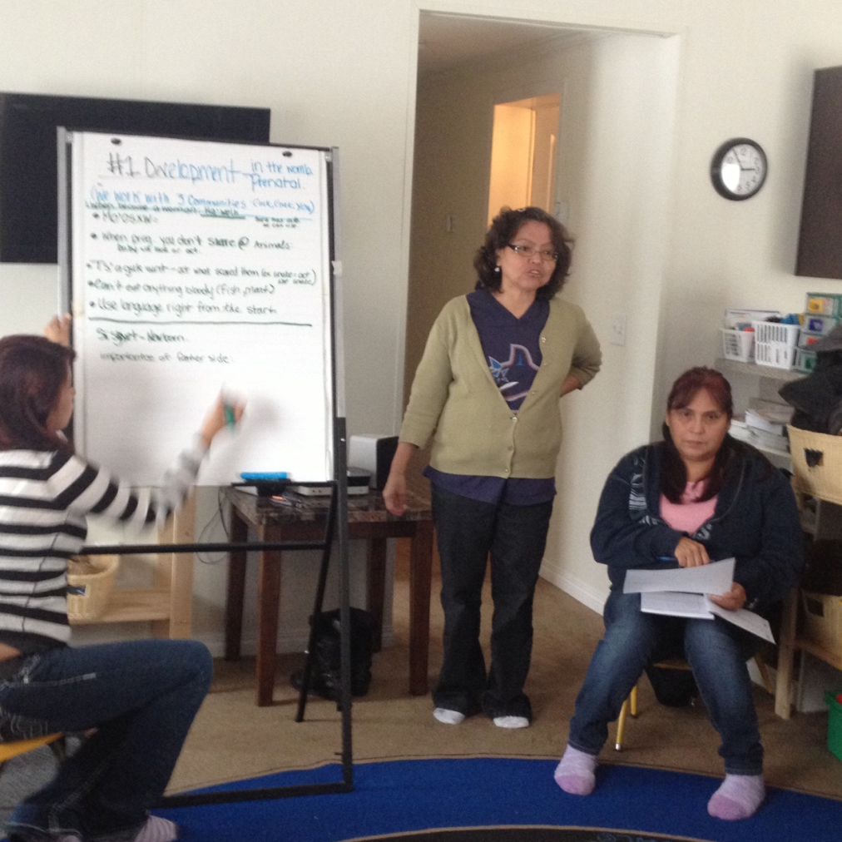
Continue to meet monthly and weekly with team
The Staff from the Language program, Elementary School, Kindergarten and grade one staff, and Daycare staff continued to meet and provide support for the event.
Everyone one who worked with children and families in the community was involved

Slide 6
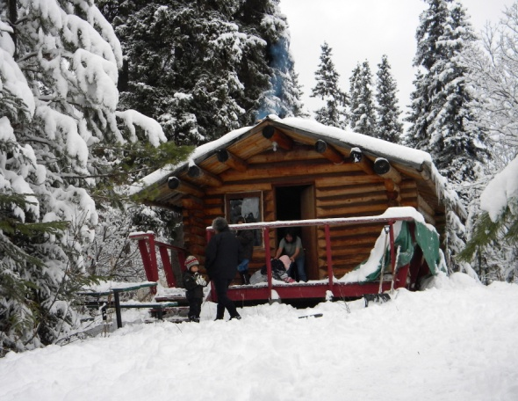

182 km return from kitwanga to terrace bc
24 km return from Kitwanga to Kitsegukla
25 km return from Kitwanga to Kitwancool
Winter months:
November to March
Challenges- time consuming to pick up food and supplies/ Elders and for transporting children and families

Slide 7
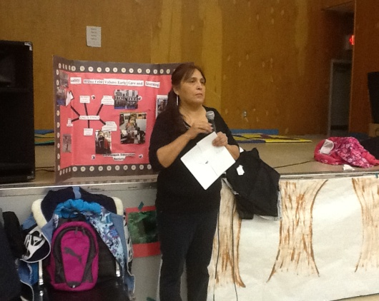
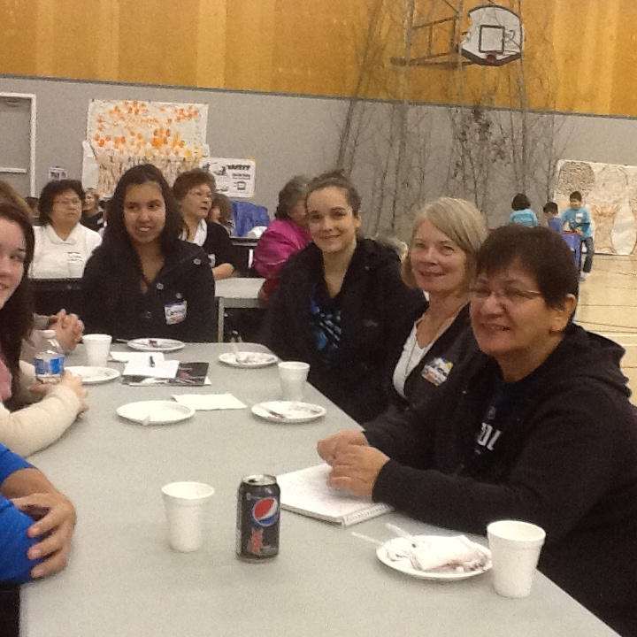
Day one- children and families
The focus for the day was to give the parents and elders the image of a daycare from the time the children arrive to the time the children leave. Liz explained though out the day, the transitions and also the clean up the staff must do once the children leave. Service providers and the ECE Students from NWCC were onsite to learn and participate

Slide 8
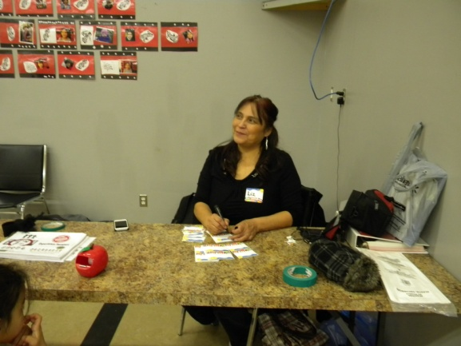
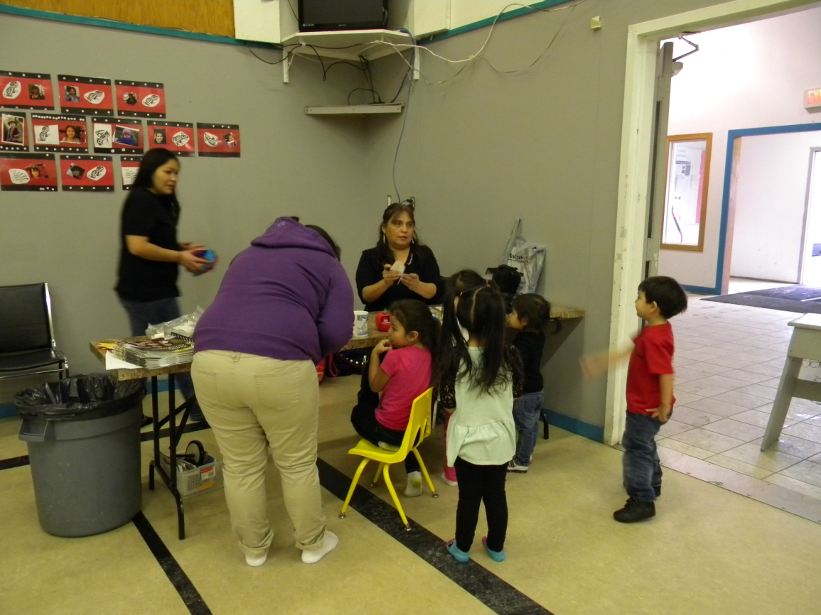
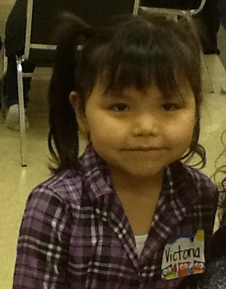
Registration for children and families
Liz explained that we would be taking photos as would NWCC for the conference, and if they agreed to give consent, then we would put a star on the child’s name tag. There was 100% verbal consent.

Slide 9
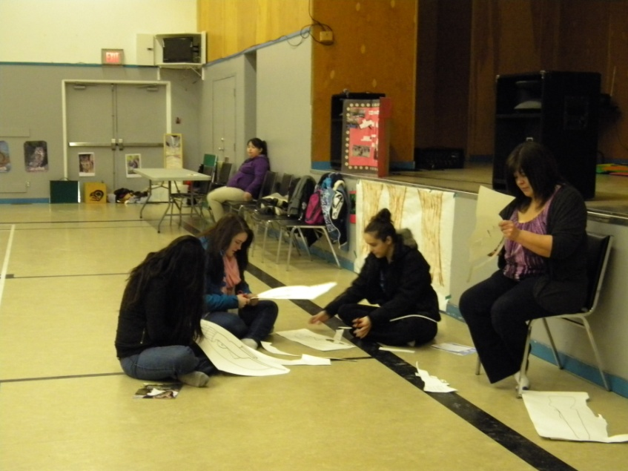
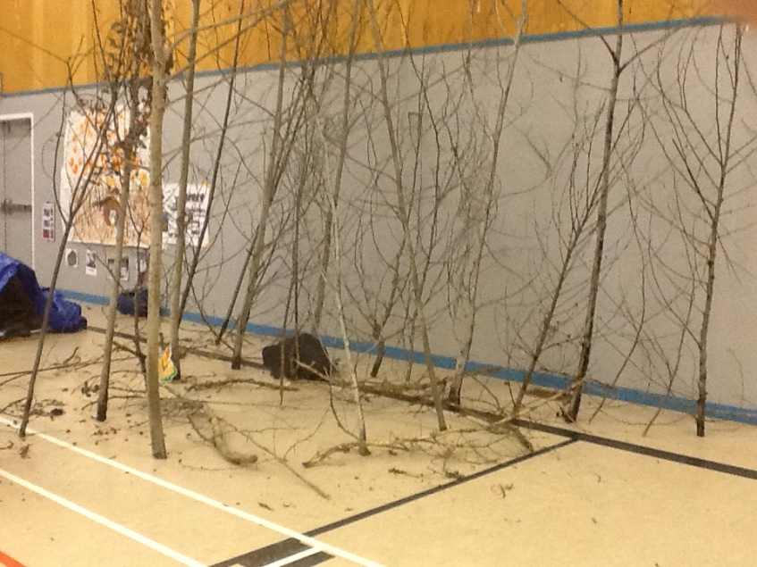
Preparing for the day
Making guns for hunting – ECE students participate
Parent contribute by setting up hunting area

Slide 10
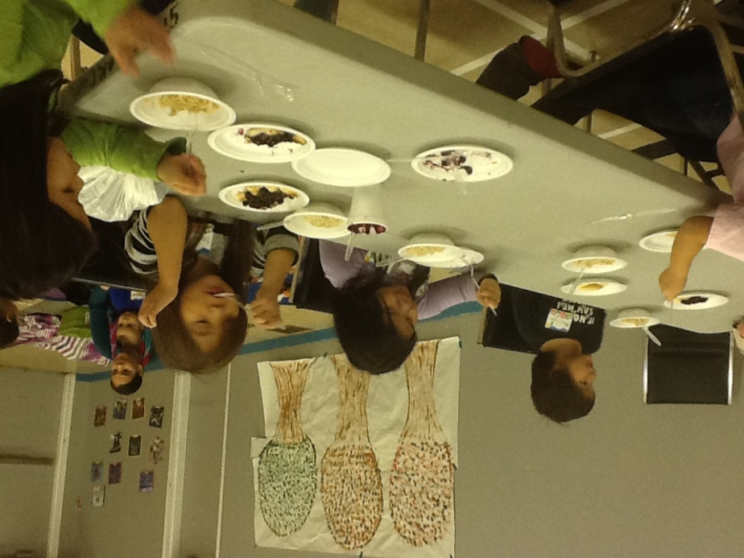
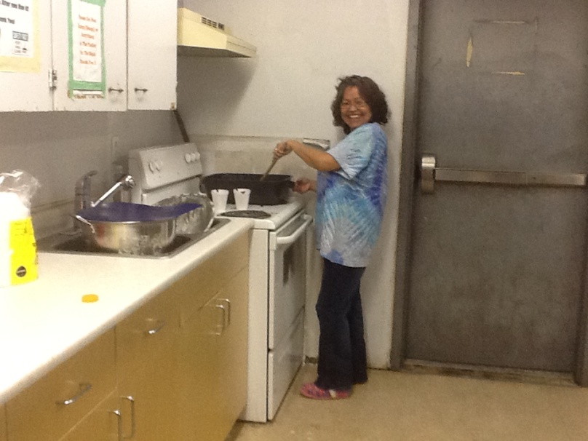
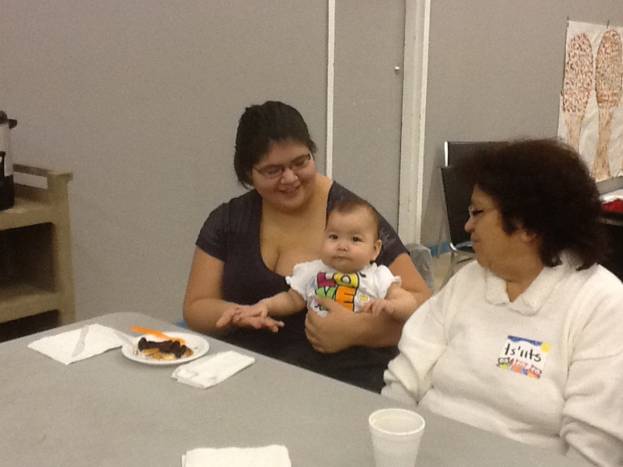
Language staff greet children and families with pancakes and huckleberries

Slide 11
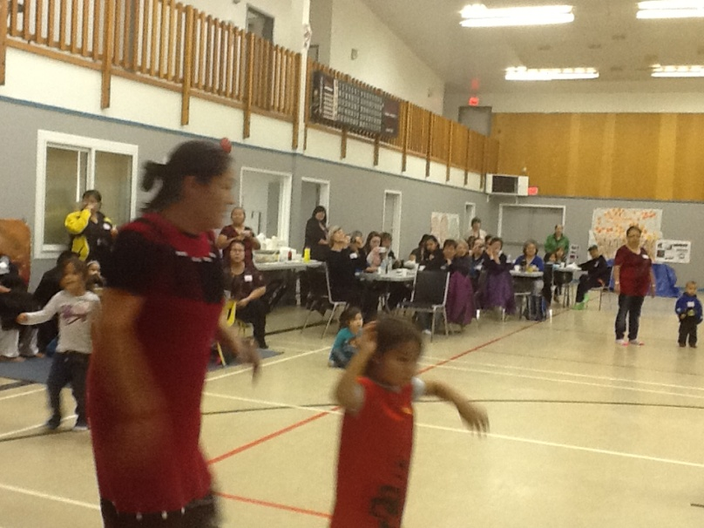
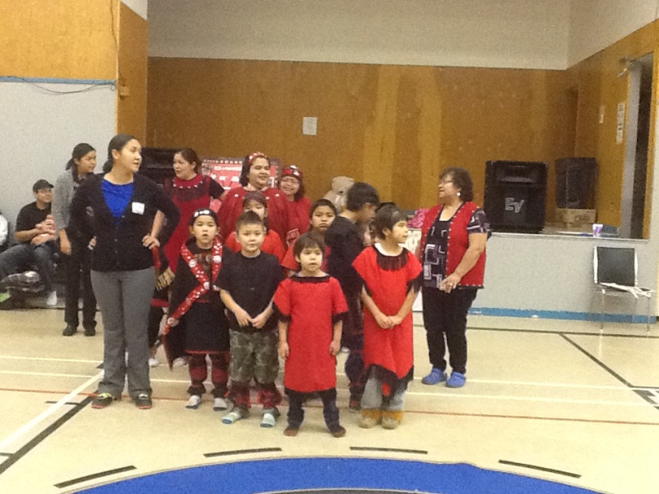
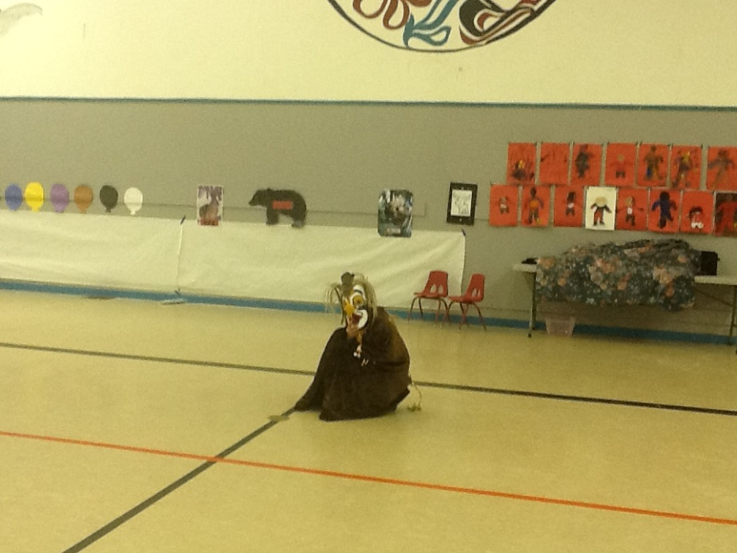
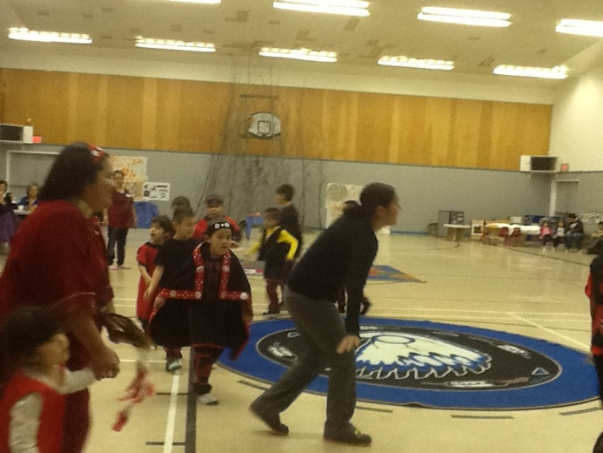
Traditional welcome from local elementary school and daycare

Slide 12
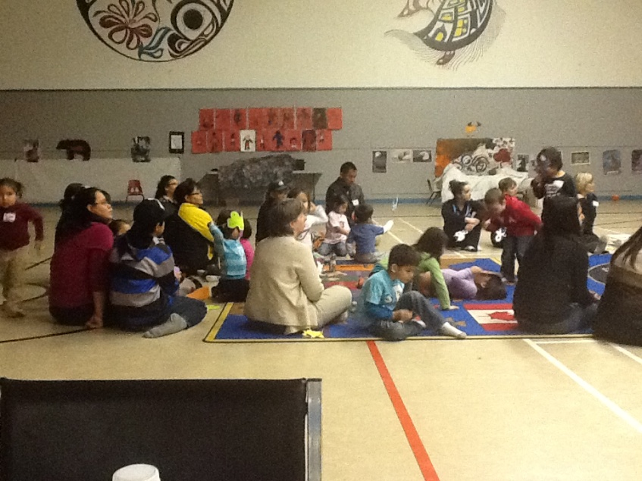
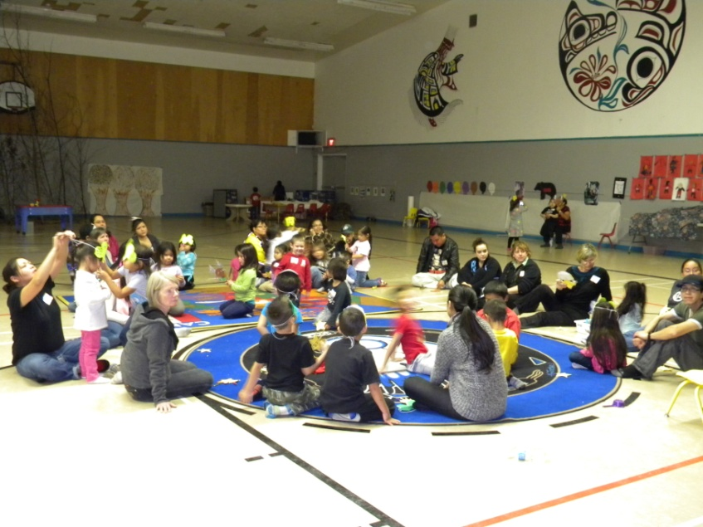
Circle time – hunting focus
Props and songs to start the day
Preparing for the animal song

